Slide 1
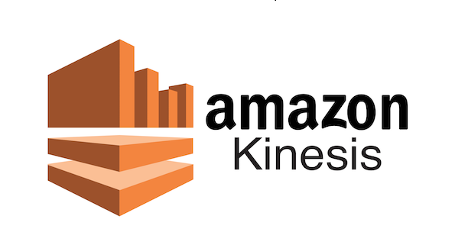

Slide 2

Topics
What is streaming data
What is Kinesis
Different types of Kinesis
Kinesis Streams
Kinesis Firehose
Kinesis Analytics

Slide 3


What is Streaming Data?
Streaming data is data that is generated continuously by thousands of data sources which typically send in the data records simultaneously and in small sizes (order of kilobytes)
Purchases from an online store such as Amazon.com.
Stock prices.
Gaming data.
Social network data
Geospatial data (like Uber)
IoT sensor data

Slide 4
What is Kinesis?
Kinesis is a platform on AWS to send your streaming data to.
Kinesis makes it easy to load and analyze streaming data and providing the ability for you to build your own custom applications for your business needs.

Slide 5


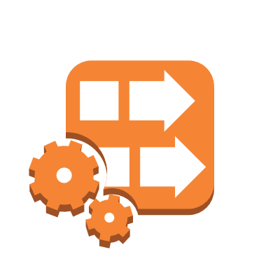
Different types of Kinesis
Kinesis Streams
Kinesis Firehose
Kinesis Analytics

Slide 6
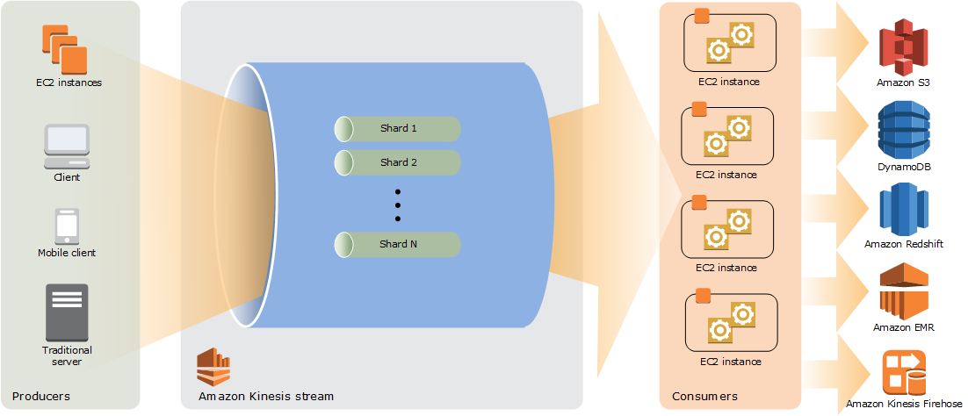
Kinesis streams
24Hours up to 7days

Slide 7
Kinesis streams consists of shards
A shard has a sequence of data records in a stream. When you create a stream, you specify the number of shards for the stream.
5 transactions per seconds for reads, up to a maximum total data read rate of 2 MB per second and up to 1,000 records per second for writes, up to a maximum total data write rate of 1 MB per second (including partition keys)
The data capacity of your stream is a function of the number of shards that you specify for a stream. The total capacity of the stream is the sum of the capacities of shards

Slide 8
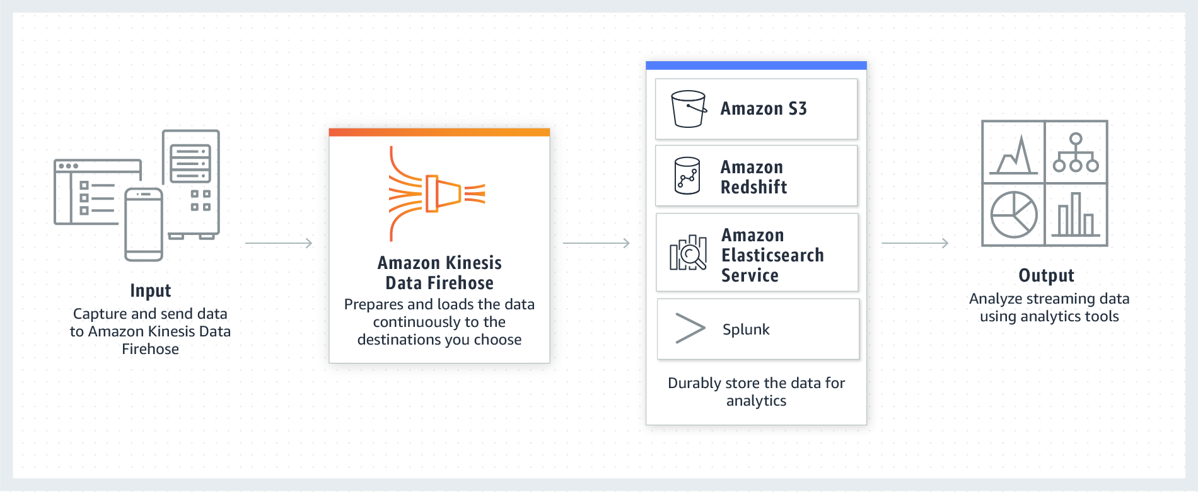
Kinesis Firehose

Slide 9
Kinesis Firehose
Amazon Kinesis Data Firehose is the easiest way to reliably load streaming data into data lakes, data stores, and analytics services. It can capture, transform, and deliver streaming data to Amazon S3, Amazon Redshift, Amazon Elasticsearch Service, generic HTTP endpoints

Slide 10
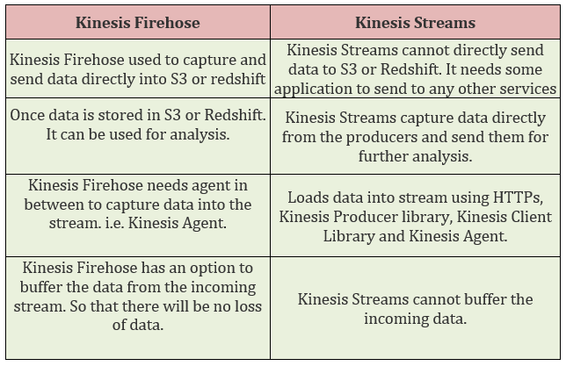
Kinesis Streams vs Kinesis Firehose

Slide 11
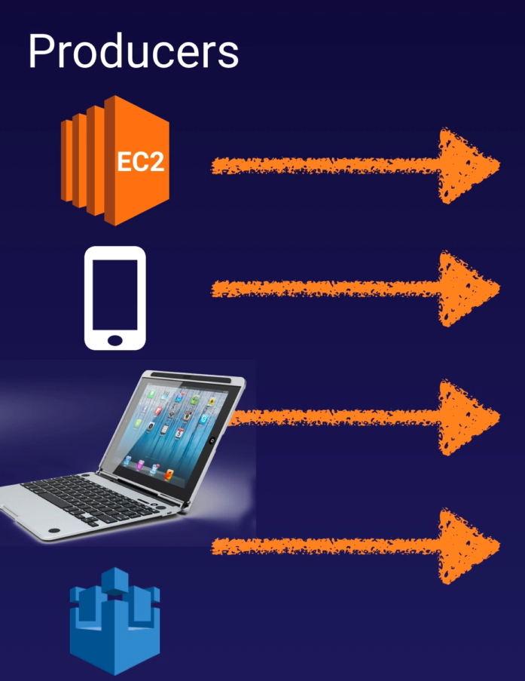
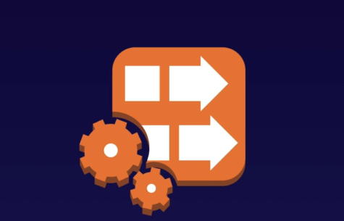
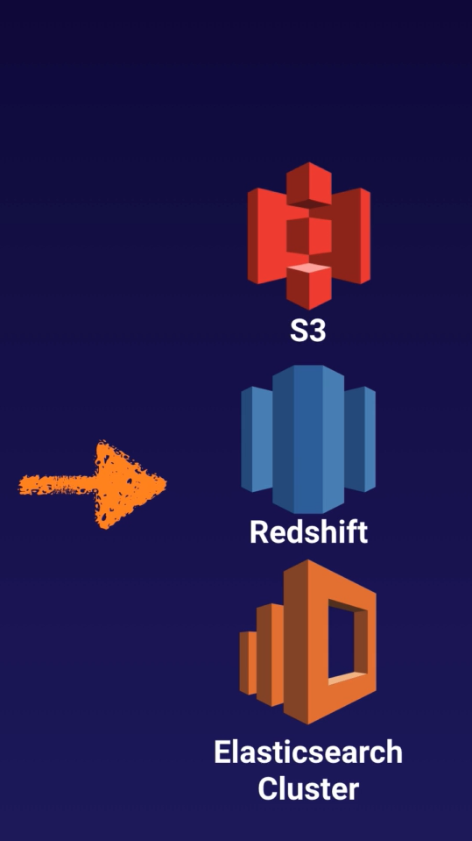
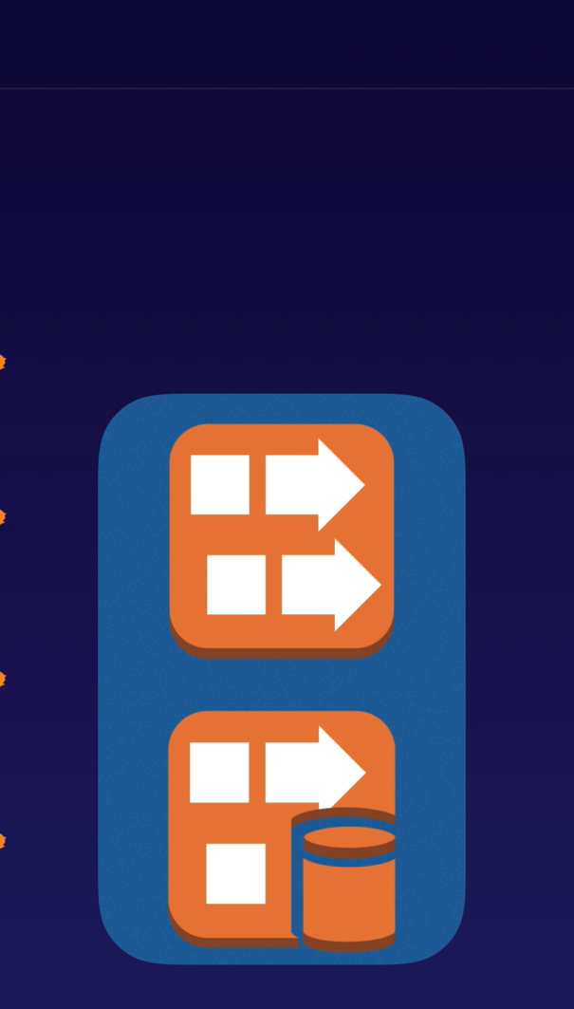
Kinesis Analytics

Slide 12
Kinesis Analytics
Amazon Kinesis Data Analytics takes care of everything required to run streaming applications continuously, and scales automatically to match the volume and throughput of your incoming data. With Amazon Kinesis Data Analytics, there are no servers to manage, no minimum fee or setup cost, and you only pay for the resources your streaming applications consume

Slide 13
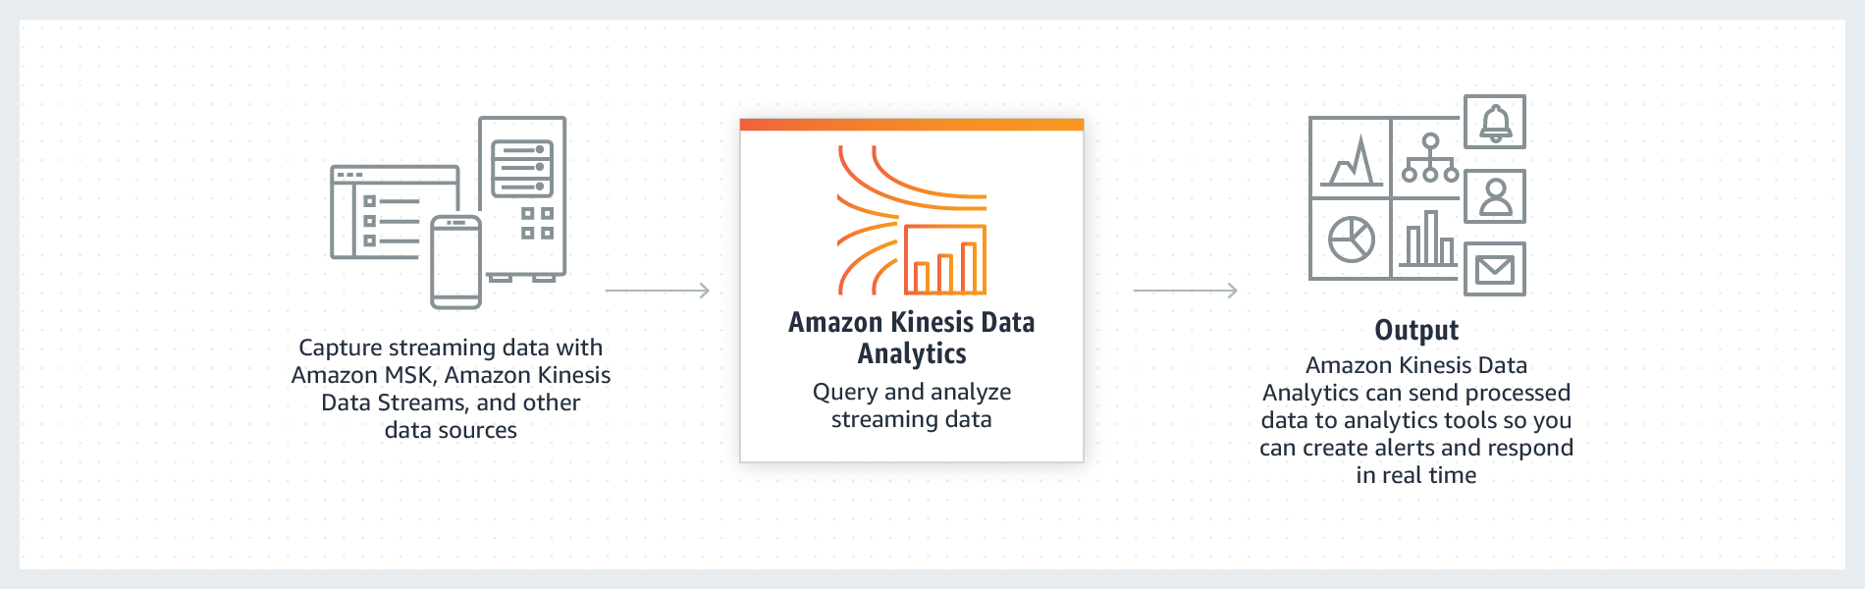
Kinesis Analytics

Slide 14
Different types of Kinesis
Kinesis Streams: Store Stream data on shards and need to consume by application
Kinesis Firehose : Doesn’t store data. Store data directly to S3 or load into Redshift
Kinesis Analytics : It transform and analyze streaming data in real time. And store data in S3, load into Redshift or Elastic Cache

Slide 15
Thank you

